Slide 1

© 2002, Cisco Systems, Inc. All rights reserved.

Slide 2

Configuring IP Access Lists
© 2002, Cisco Systems, Inc. All rights reserved.
Notes:
Purpose: This chapter introduces the Cisco IOS™ CLI on the Catalyst® 1900 switch and router.
Timing: This chapter should take about 2 hours to present.
Note: The Catalyst 1900 switch only has a subset of the router Cisco IOS commands available.
Contents:
Introduction to Cisco IOS. Explain to the student what is IOS?
Cisco Device startup procedures in general.
IOS configuration source.
General introduction to the IOS CLI.
Cat 1900 switch startup procedures.
Intro to Cat 1900 CLI. This part covers the basic configuration on the switch, like setting the IP address and hostname. More details about the various Cat 1900 switch configuration commands are explained in Chapter 6 and 7.
Router startup procedures. More details on the router startup process is discussed in chapter 5.
Router IOS CLI.

Slide 3
Objectives
Upon completing this lesson, you will be able to:
  Use Cisco IOS commands to configure IP standard and extended access lists, given a functioning router
  Use show commands to identify anomalies in IP standard and extended access lists, given an operational router
Notes:
Slide 1 of 2
Purpose: This slide states the chapter objectives.
Emphasize: Read or state each objective so that each student has a clear understanding of the chapter objectives.
Note: Catalyst switches have different CLIs. The Catalyst 2900xl and the Catalyst 1900 has a Cisco IOS CLI. The Cisco IOS CLI commands available on the 2900xl is different from the 1900. The Catalyst 5000 family has no Cisco IOS CLI, and use the set commands instead. This class only covers the configuration on the Catalyst 1900 switch.

Slide 4
Access List Configuration Guidelines
  Access list numbers indicate which protocol is filtered.
  One access list per interface, per protocol, per direction is allowed.
  The order of access list statements controls testing.
  Place the most restrictive statements at the top of list.
  There is an implicit deny any statement as the last access list test. Every list needs at least one permit statement.
  Create access lists before applying them to interfaces.
  Access lists filter traffic going through the router; they do not apply to traffic originating from the router.

Slide 5
Access List Command Overview
Step 1: Set parameters for this access list test
statement (which can be one of several statements).
Router(config)#access-list access-list-number
{permit | deny} {test conditions}
Step 2: Enable an interface to use the specified
access list.
Router(config-if)#{protocol} access-group
access-list-number {in | out}
  Standard IP lists (1-99)
  Extended IP lists (100-199)
  Standard IP lists (1300-1999) (expanded range)
  Extended IP lists (2000-2699) (expanded range)
Notes:
Layer 2 of 2
Emphasize: Layer 2—Adds the general form of the interface command. This links the previously specified interface to a group that will handle its packet for the protocol in the manner specified by the global access list statements.
It can help student understanding to learn a generalized command as a simplified template, common to most access list processes. However, the details for specific access lists vary widely.
As you present the global access list command material that follows in this chapter, return to the template term “test conditions” if it helps your students associate variations to the general elements of this model.
Emphasize that “test conditions” is an abstraction for this course. Use this abstraction as a generalization to assist teaching and learning. The words “test conditions” are not a Cisco IOS argument or parameter.
Cisco IOS software also offers many variations for the second interface command. As you present these variations, refer your students to the template term “access group” and emphasize how each variation performs a link of the access list test conditions met and the interfaces that packets can use as a result.

Slide 6
Standard IP Access List Configuration
Router(config)#access-list access-list-number
{permit | deny | remark} source [mask]
  Sets parameters for this list entry
  IP standard access lists use 1 to 99
  Default wildcard mask = 0.0.0.0
  no access-list access-list-number removes entire access list
  remark option lets you add a description for the access list
Router(config-if)#ip access-group
access-list-number {in | out}
  Activates the list on an interface
  Sets inbound or outbound testing
  Default = outbound
  no ip access-group access-list-number removes access list from
  the interface
Notes:
Layer 2 of 2
Purpose: This layer shows the ip access-group command.
Emphasize: The ip access-group command links an access list to an interface. Only one access list per interface, per direction, per protocol is allowed.
The ip access-group field descriptions are as follows:
list—Number of the access list to be linked to this interface.
direction—Default is outbound.
Note: Create the access list first before applying it to the interface. If it is applied to the interface before it is created, the action will be to permit all traffic. However, as soon as you create the first statement in the access list, the access list will be active on the interface. Since there is the implicit deny all at the end of every access list, the access list may cause most traffic to be blocked on the interface.
To remove an access list, remove it from all the interfaces first, then remove the access list. In older versions of Cisco IOS, removing the access list without removing it from the interface can cause problems.

Slide 7
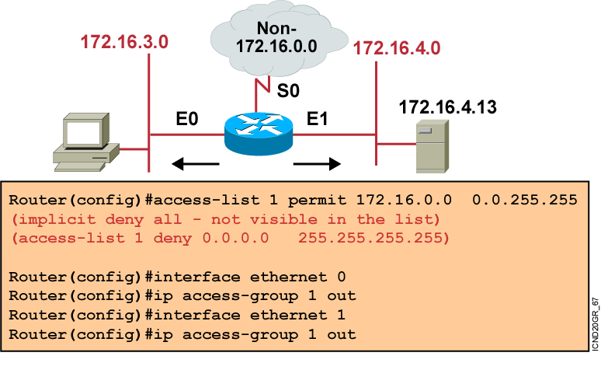
Standard IP Access List
Example 1
  Permit my network only.
Notes:
Layer 2 of 2
Emphasize: Because of the implicit deny all, all non-172.16.x.x traffic is blocked going out E0 and E1.
Note: The red arrows represent the access list is applied as an outbound access list.

Slide 8
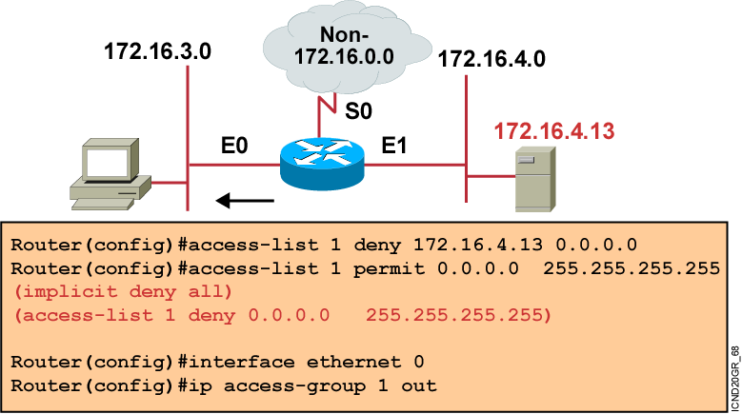
Standard IP Access List
Example 2
  Deny a specific host.
Notes:
Layer 3 of 3
Emphasize: Only host 172.16.4.13 is blocked from going out on E0 to subnet 172.16.3.0.
Ask the students what will happen if the access list is placed as an input access list on E1 instead. Host 172.16.4.13 will be blocked from going out to the non-172.16.0.0 cloud, as well as to subnet 172.16.3.0.
Note: The red arrows represent the access list is applied as an outbound access list.

Slide 9
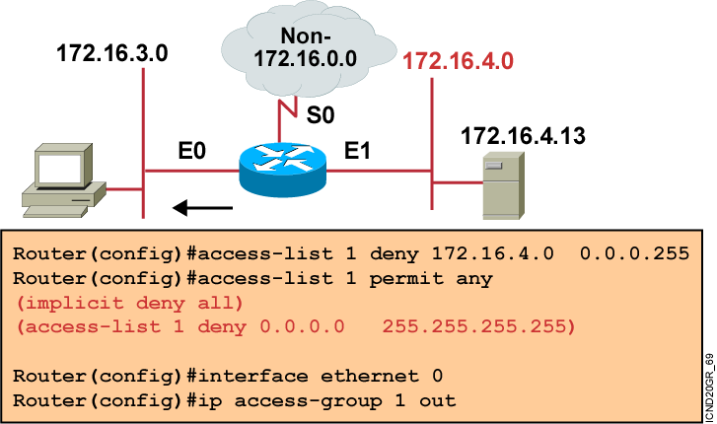
Standard IP Access List
Example 3
  Deny a specific subnet.
Notes:
Layer 2 of 2
Emphasize: All hosts on subnet 172.16.4.0 are blocked from going out on E0 to subnet 172.16.3.0.
Note: The red arrows represent the access list is applied as an outbound access list.

Slide 10
Extended IP Access List Configuration
Router(config)#access-list access-list-number
{permit | deny} protocol source source-wildcard [operator port] destination destination-wildcard [operator port] [established] [log]
  Sets parameters for this list entry
Router(config-if)#ip access-group access-list-number {in | out}
  Activates the extended list on an interface
Notes:
Layer 2 of 2
Purpose: Layer 2—Adds the access-group command for IP.
Emphasize: The list number must match the number (100 to 199) you specified in the access-list command.

Slide 11
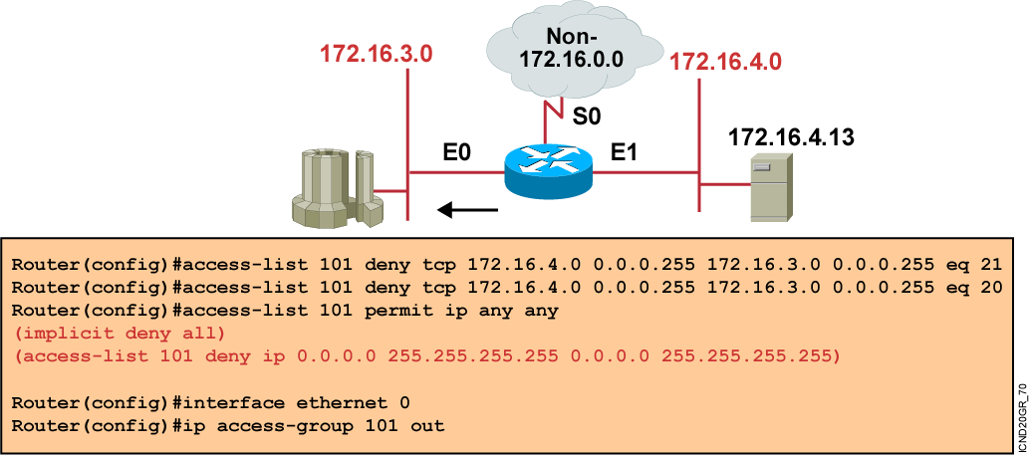
Extended Access List
Example 1
  Deny FTP from subnet 172.16.4.0 to subnet 172.16.3.0 out of E0.
  Permit all other traffic.
Notes:
Layer 3 of 3

Slide 12
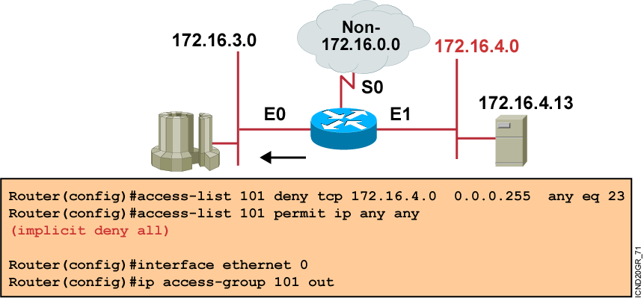
Extended Access List
Example 2
  Deny only Telnet from subnet 172.16.4.0 out of E0.
  Permit all other traffic.
Notes:
Layer 3 of 3

Slide 13
Using Named IP Access Lists
Router(config)#ip access-list {standard | extended} name
Alphanumeric name string must be unique.
Router(config {std- | ext-}nacl)#{permit | deny}
{ip access list test conditions}
{permit | deny} {ip access list test conditions}
no {permit | deny} {ip access list test conditions}
Permit or deny statements have no prepended number.
“no” removes the specific test from the named access list.
Router(config-if)#ip access-group name {in | out}
Activates the IP named access list on an interface.
Notes:
Layer 3 of 3
Purpose: Layer 3—Finishes with the new form of the access-group command, now able to refer to an IP access list name as well as an access list number.
Emphasize: Introduced with Cisco IOS Release 11.2, named access lists:
Intuitively identify IP access lists using alphanumeric identifiers.
Remove the limit on the number of access lists (previously 99 for IP standard and 100 for IP extended access lists).
Allow per-access-list statement deletions (previously the entire numbered access list needed to be deleted as a single entity).
Require Cisco IOS Release 11.2 or later.

Slide 14
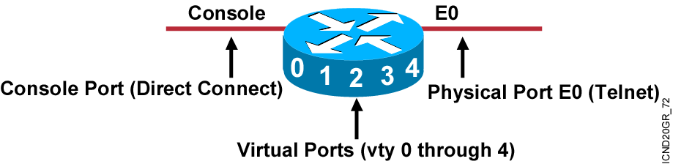
Filtering vty Access to a Router
  Five virtual terminal lines (0 through 4).
  Filter addresses that can access into the router’s
  vty ports.
  Filter vty access out from the router.
Notes:
Emphasize: Instead of applying a standard access list to a physical interface, now we will apply a standard access list to the router’s vty ports. A vty port is a logical port on the router that can accept Telnet sessions.
Note: Access class is used to filter incoming Telnet sessions into the router’s vty ports and filter outgoing Telnet sessions from the router’s vty port.
Access class always uses a standard access list to match the source address of the incoming Telnet session, and the destination address of the outgoing Telnet session.
The 2500 series router, by default, has 5 vty ports (vty 0 through 4).
To configure more vty ports, use the following global configuration command:
RouterB(config)#line vty 0 ?
<1-188> Last Line number
<cr>

Slide 15
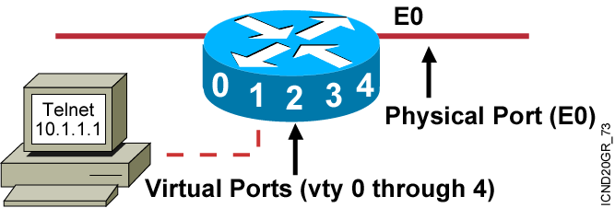
How to Control vty Access
  Set up an IP address filter with a standard access list statement.
  Use line configuration mode to filter access with the access-class command.
  Set identical restrictions on every vty.
Notes:
Emphasize: To filter incoming and outgoing Telnet sessions to and from the router’s vty ports, the standard access list is used.
If this is to block incoming Telnet sessions into a router’s vty port, the standard access list is used to match the source address of the host trying to Telnet into the router’s vty port.
If this is to block outgoing Telnet sessions from the router’s vty ports to a host, the standard access list is used to match the destination address of the host the router is trying to Telnet into from its vty ports.

Slide 16
vty Commands
Router(config)#line vty {vty# | vty-range}
  Enters configuration mode for a vty or vty range
Router(config-line)#access-class access-list-number {in | out}
  Restricts incoming or outgoing vty connections for address in the access list
Notes:
Emphasize: Use the access-class command to apply the standard access list to the vty port. The next slide shows a configuration example.

Slide 17
vty Access Example
Controlling Inbound Access
access-list 12 permit 192.168.1.0 0.0.0.255
(implicit deny all)
!
line vty 0 4
access-class 12 in
  Permits only hosts in network 192.168.1.0 0.0.0.255 to connect to the router vty
Notes:
Purpose: This example shows how to restrict incoming Telnet sessions to the router’s vty ports.
Emphasize: The access class is applied as an input filter.
Note: Ask the student about the effect of changing the direction of the access class to outbound instead of inbound.
Now the router can accept incoming Telnet sessions to its vty ports from all hosts, but will block outgoing Telnet sessions from its vty ports to all hosts except hosts in network 192.89.55.0.
Once a user is Telneted into a router’s vty port, the outbound access-class filter will prevent the user from Telneting to other hosts as specified by the standard access list.
Remember, when an access list is applied to an interface, it only blocks or permits traffic going through the router, it does not block or permit traffic initiated from the router itself.

Slide 18
Access List Configuration Principles
  The order of access list statements is crucial.
    Recommended: Use a text editor on a PC to create the access-list statements, then cut and paste them into the router.
    Top-down processing is important.
    Place the more specific test statements first.
  No reordering or removal of statements.
    Use the no access-list number command to remove the entire access list.
    Exception: Named access lists permit removal of individual statements.
  Implicit deny all will be applied to any packets that do not match any access-list statement.
    Unless the access list ends with an explicit permit any statement.

Slide 19
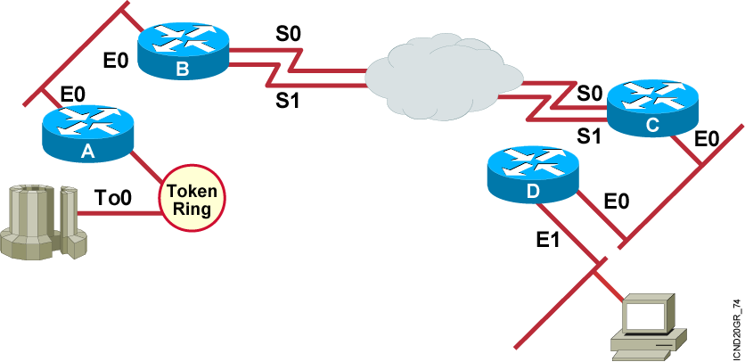
Where to Place IP Access Lists
  Place extended access lists close to the source.
  Place standard access lists close to the destination.
Notes:
Emphasize: Explain the basic rules about where to configure standard and extended access lists.
Describe how the extended access list can eliminate unwanted traffic across the serial lines.

Slide 20
Verifying Access Lists
wg_ro_a#show ip interfaces e0
Ethernet0 is up, line protocol is up
Internet address is 10.1.1.11/24
Broadcast address is 255.255.255.255
Address determined by setup command
MTU is 1500 bytes
Helper address is not set
Directed broadcast forwarding is disabled
Outgoing access list is not set
Inbound access list is 1
Proxy ARP is enabled
Security level is default
Split horizon is enabled
ICMP redirects are always sent
ICMP unreachables are always sent
ICMP mask replies are never sent
IP fast switching is enabled
IP fast switching on the same interface is disabled
IP Feature Fast switching turbo vector
IP multicast fast switching is enabled
IP multicast distributed fast switching is disabled
<text ommitted>
Notes:
Purpose: This slide shows how to verify an access list.
Emphasize: Lists IP interface information. Indicates whether the outgoing access list is set.
Review the output of the show ip interface command. The highlighted text shows details about access list settings in the show command output.

Slide 21
Monitoring Access List Statements
    wg_ro_a#show {protocol} access-list {access-list number}
    wg_ro_a#show access-lists {access-list number}
    wg_ro_a#show access-lists
    Standard IP access list 1
    permit 10.2.2.1
    permit 10.3.3.1
    permit 10.4.4.1
    permit 10.5.5.1
    Extended IP access list 101
    permit tcp host 10.22.22.1 any eq telnet
    permit tcp host 10.33.33.1 any eq ftp
    permit tcp host 10.44.44.1 any eq ftp-data
Notes:
Purpose: This slide introduces the show access-lists command used to verify access lists.
Emphasize: This is the most consolidated method for seeing several access lists.
Note: The implicit deny all statement is not displayed unless it is explicitly entered in the access list.

Slide 22
Summary
  Well-designed and implemented access lists will add an important security component to your network.
  To configure standard IP access lists on a Cisco router, you will create a standard IP access list and activate an access list on an interface.
  Similarly, to configure extended IP access lists on a Cisco router, you will create an extended IP access list range and activate an access list on an interface.
  The named access list feature allows you to identify IP standard and extended access lists with an alphanumeric string (name) instead of the current numeric (1 to 199 and 1300 to 2699) representations.
Notes:
Purpose: This slide discuss the initial configurations on the routers and switches.
Note: There is no setup mode on the Catalyst 1900 switch.

Slide 23
Summary (Cont.)
  For security purposes, you can deny Telnet access to the router, or you can permit Telnet access to the router but deny access to destinations from that router. Restricting Telnet access is primarily a technique for increasing network security.
  Access lists are used to control traffic by filtering and eliminating unwanted packets. Proper placement of an access list statement can reduce unnecessary traffic.
  When you finish the access list configuration, you can verify it using the show commands.

Slide 24


